Slide 1


Meta Project
By Pooja Gurumurti

Slide 2
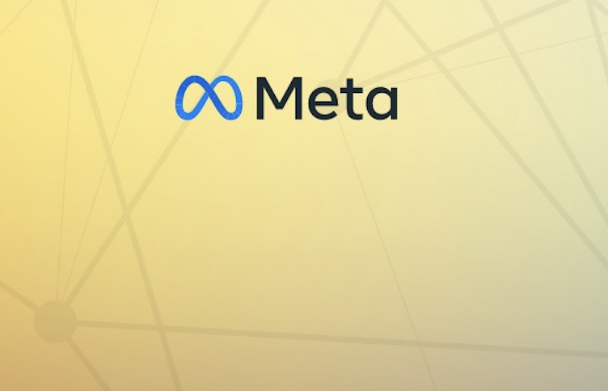
Table of Contents
About Meta
Problem Statement
Data Overview
Approach
Engagement Analysis
Users Classification
Content Performance
Advertisement Strategy
Campaigns and Projections
Conclusion

Slide 3

About Meta
In 2004, Mark Zuckerberg laid the foundation for this vision with the launch of Facebook, a social media platform that would go on to change the way we interact online. Fast forward to October 2021, when the company rebranded as Meta, signaling its commitment to building the metaverse – a digital frontier where people can connect, work, and play in virtual worlds that seamlessly blend with the physical world.
Meta's ecosystem is a rich tapestry of technologies and platforms, each designed to enhance the user experience. From social media giants like Facebook, Instagram, and WhatsApp to cutting-edge augmented and virtual reality technologies like Oculus, every component works in harmony to bring the metaverse to life.As we embark on this exciting journey, one thing becomes clear: the metaverse has the potential to revolutionize human connection. Imagine attending virtual concerts, collaborating with colleagues from around the world, or simply hanging out with friends in a virtual environment that feels almost indistinguishable from reality. The possibilities are endless, and Meta is at the forefront of this revolution.

Slide 4
Problem Statement
You are hired as a data analyst at Meta and asked to collaborate with the Marketing team. Marketing teams want to leverage Instagram's user data to develop targeted marketing strategies that will increase user engagement, retention, and acquisition. Provide insights and recommendations to address the following objectives.

Slide 5
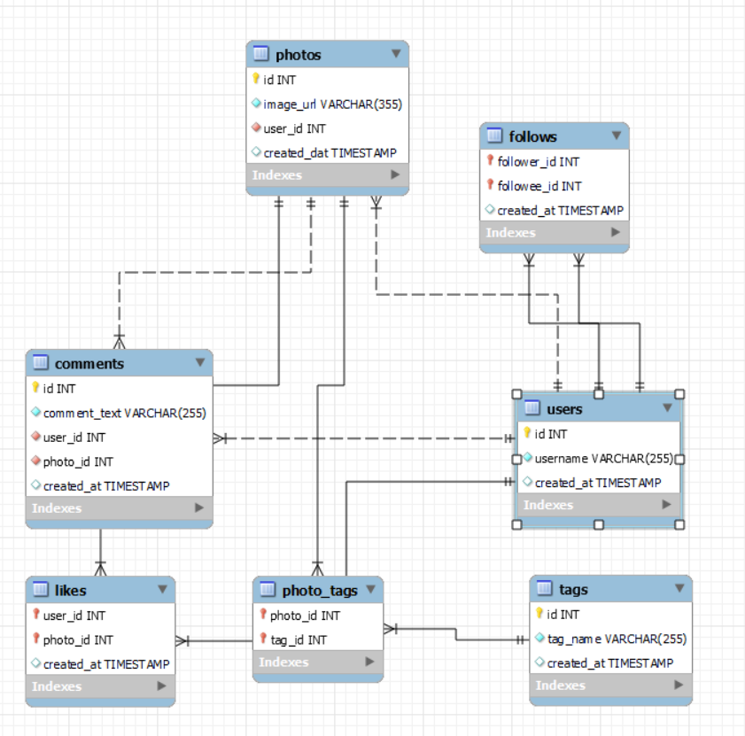
Data Overview
Total 7 Tables are present in the given dataset.
Total number of users are 100.
Total number of posts made so far is 257.
Total number of likes posted by the users on posts is 8782.
Total number of comments on all posts are 7488.
Total number of engagement is calculated by adding total likes and total comments by an user.
Engagement rate is calculated by dividing total engagements by number of posts.

Slide 6
Approach
Understanding Statistics: Calculated basic statistics like total number of users and respective posts posted, likes, comments achieved
Data Cleaning and Validation: Checked and removed duplicates in the data sets also treated null values.
Analysis: Utilized sql techniques such as Common Table Expressions (CTE), Aggregate Functions:(AVG, COUNT,ROUND, etc), Subqueries, Group By clause, Rank,Window functions.
Data Visualization: Visualized key metrics such as total posts, likes, and comments to provide a clear representation of user activity levels. Created charts and graphs to rank users based on engagement rates and to highlight the most influential hashtags.
Strategy Making: Prepared plans and strategies for increasing user retention and increasing engagement activities.
Implementation-Implementation of the plans and strategy are also discussed for optimised and better results.

Slide 7
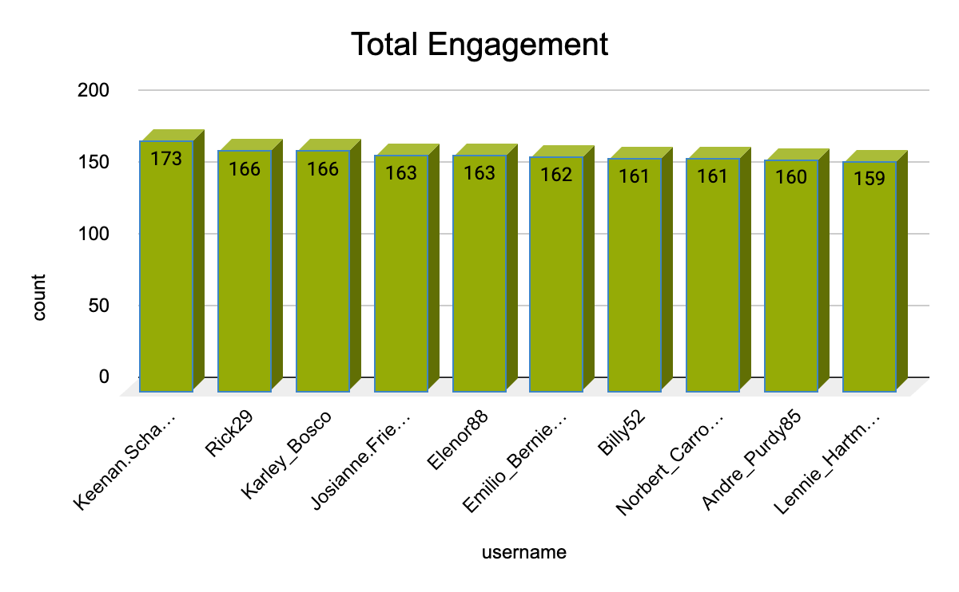
Engagement Analysis
Top Users have engagement from 149 to 166.
Average engagement rate of all users is 65.
Only 31 users have more than average engagement rate and 18 users have more than 100.
We will track their posts that gets most of the likes and comments and promote those kind of content.

Slide 8
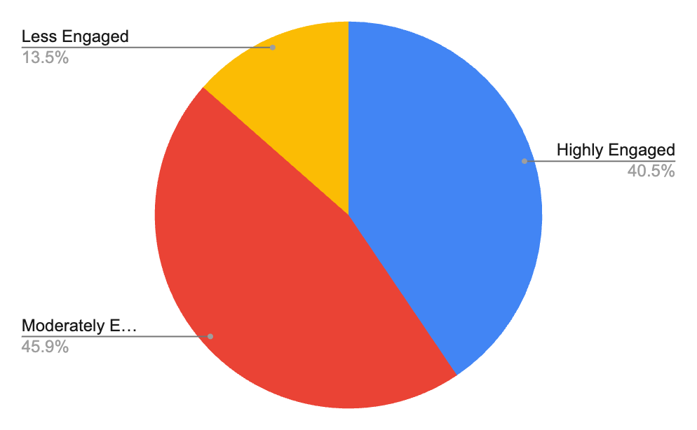
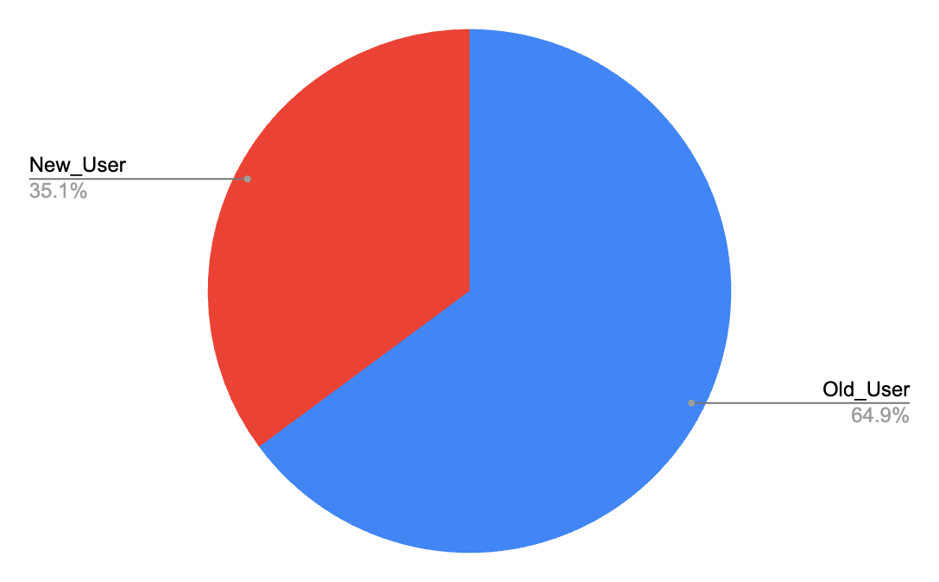
User Classification
There are 30 Users who come under Highly Engaged category.
34 Users come under Moderately Engaged category.
10 user come in Less Engaged category.
65% of the current total users are old users. (Joined before 2017)
Remaining 35% users are New means
They joined after 2017.
These classification is so that personalized ads and campaigns can be made for different class to improve engagement rates and make interface user friendly.

Slide 9
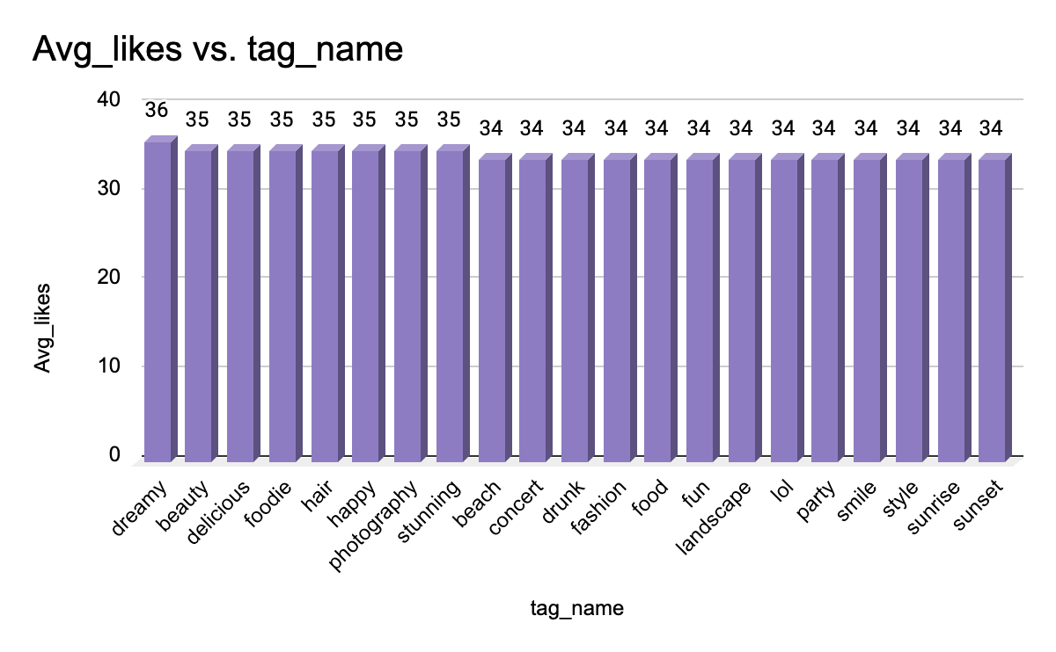
Content Performance
Dreamy Tag has the highest likes where as foodie tags has lowest number of likes.
Hashtags with high count of Likes are the popular tags among all.
Popular tags will be promoted and influencers will promote popular tags by using them in their posts.
Contents related to these tags should be frequently shown on explore pages of the users to engage them.
Tags other than dreamy have very much same no. of likes so they should also be optimised.

Slide 10
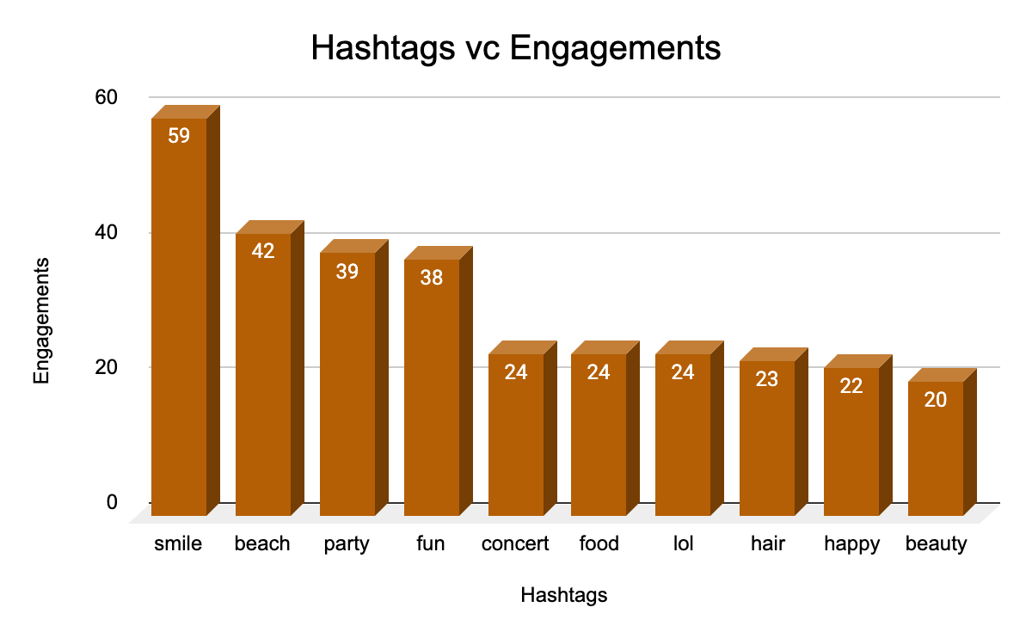
Engagement Rates
To maximize user engagement and drive campaign success, it's essential to identify and leverage high-engagement hashtags. These hashtags are associated with posts that have garnered significant likes, comments, and shares, making them a valuable asset for content strategy and ad campaigns.
Monitor hashtag performance over time to identify trends and patterns.
Design ad creative that incorporates high-engagement hashtags, increasing relevance and engagement.

Slide 11
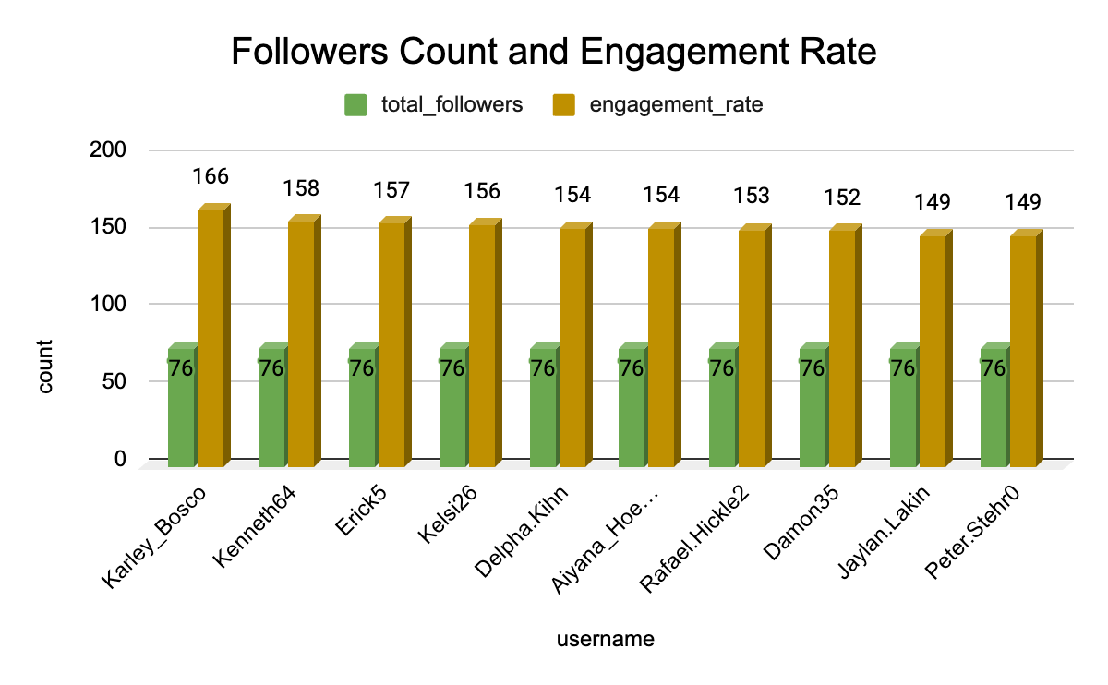
Advertisement Strategy
Ad campaigns on the basis of user’s category.
Utilise user data for personalised ad and content.
Notifications and recommendations should be given on the basis of content users follow and like the most.
Collaborations with the Highly engaged users to encourage others for re-engaging on the platform.

Slide 12

Campaigns and Projections
Target audience on the basis of categories and content they brows.
Personalised notification and emails should be send the the users to increase engagement.
Notification should be catchy and funny so user may not feel disturbed and irritated.
Analyse the ad campaigns which are getting low response and substitute them.
Collaborations should be done with brands and users, pay the user for paid posts who have better reach and engagement.

Slide 13
Conclusion
According to the analysis of current data users divided into 3 categories i.e Highly engaged, Moderately engaged and Less engaged.
Special focus should be given on Less engaged users.
Hashtags play a very vital role is user engagement and promoting any content.
Hashtags should be properly monitored and utilised according to the trending and hot topics.
Reels are now more liked and engaging among new users.
Making reels should be promoted among users and influencers should be motivated to make reels related to trending hashtags.
Ads and Campaigns should regularly be made optimising with trends.
Promotion through notification should be done via tests and mails.

Slide 14
